Slide 1

Bank Loan Analysis
Created by Datta Hadawale

Slide 2
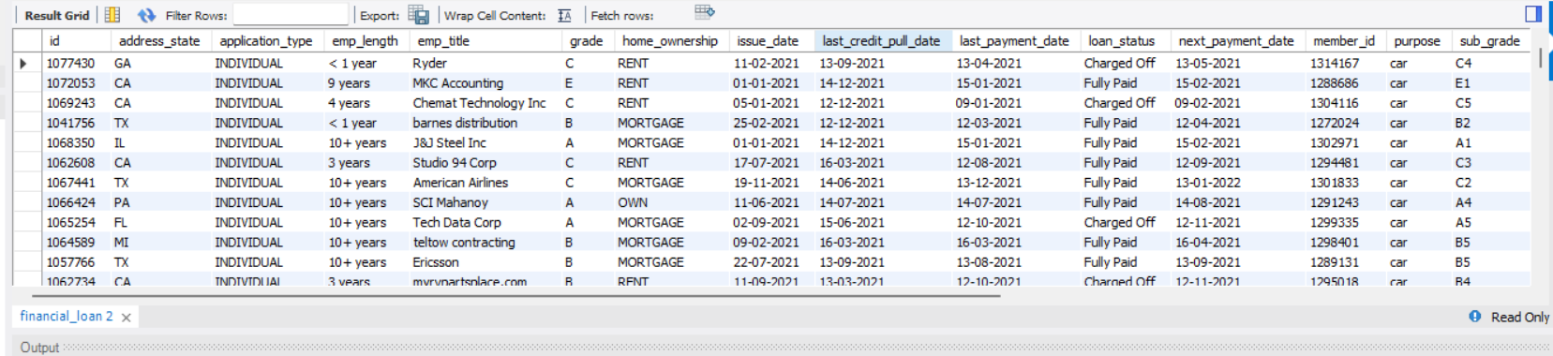
Dataset

Slide 3

Objective
To analyze bank loan applications and identify monthly application trends.
To track total funded amounts, total amounts received, and average interest rates.
To evaluate good loans and bad loans to understand loan portfolio performance.
To analyze loan applications based on state, loan purpose, loan grade, employment length, and home ownership.
To monitor borrowers’ debt-to-income (DTI) ratios and assess potential credit risk.
To develop an interactive Power BI dashboard for effective data visualization and data-driven decision-making.

Slide 4
Good vs Bad Loan

Slide 5
Loan Performance Comparison
• Analyze loan applications, funded amounts, and repayments.
• Identify good loans and bad loans to evaluate loan performance.
• Analyze loan data by state, purpose, loan grade, and borrower profile.
Class | Good Loan | Bad Loan
Loan Applications | 95.2% | 4.8%
Loan Performance | Performing loans | Charged-off loans
Risk Level | Lower risk | Higher risk

Slide 6
Overviews
Summary
Overviews
Loan Applications by Month and State
Analysis by Term, Purpose, and Home Ownership
Details
Loan Application Records
Good Loan vs. Bad Loan Analysis
Funded Amount, Interest Rate, and Installment Details
Key Performance Indicators (KPIs)
Analyze overall bank loan performance.
Identify loan trends and borrower patterns.
Evaluate good loans, bad loans, and potential credit risks.

Slide 7
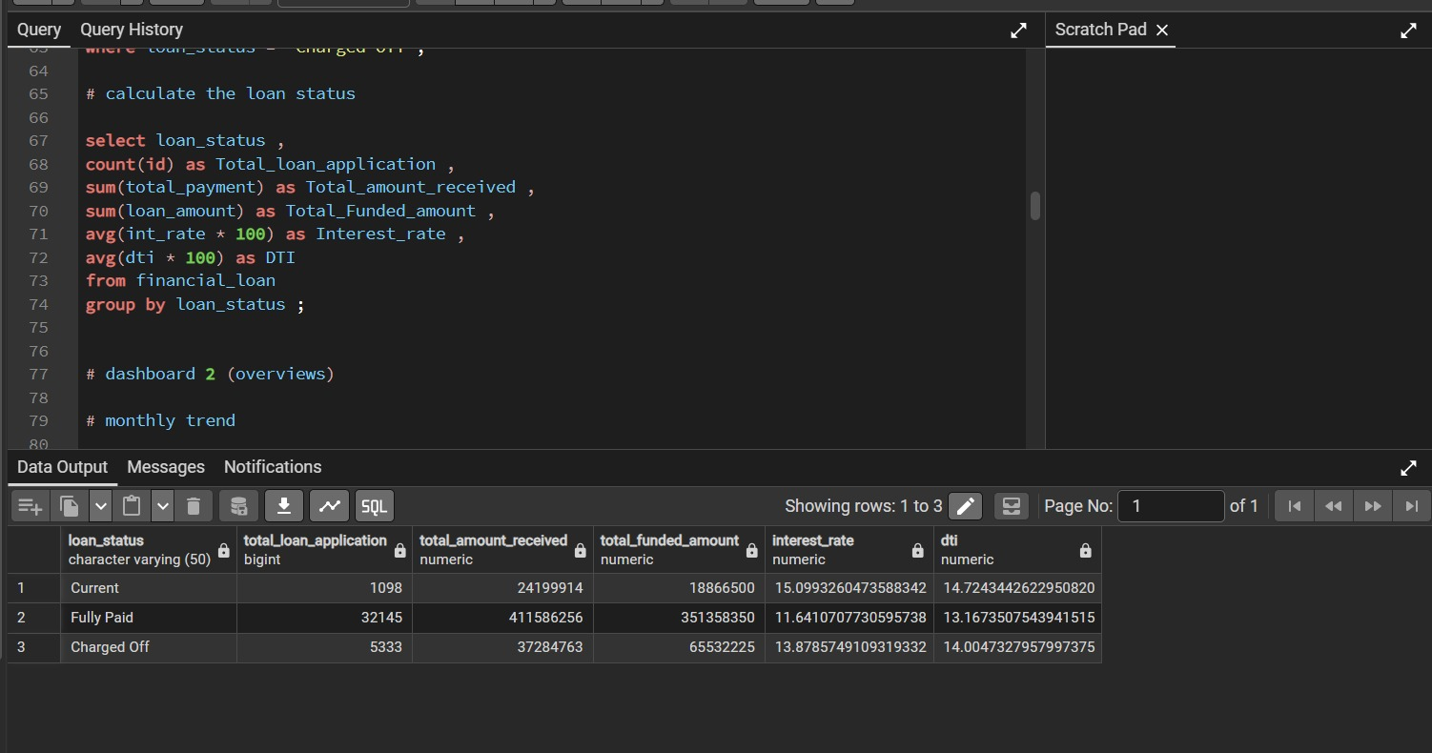
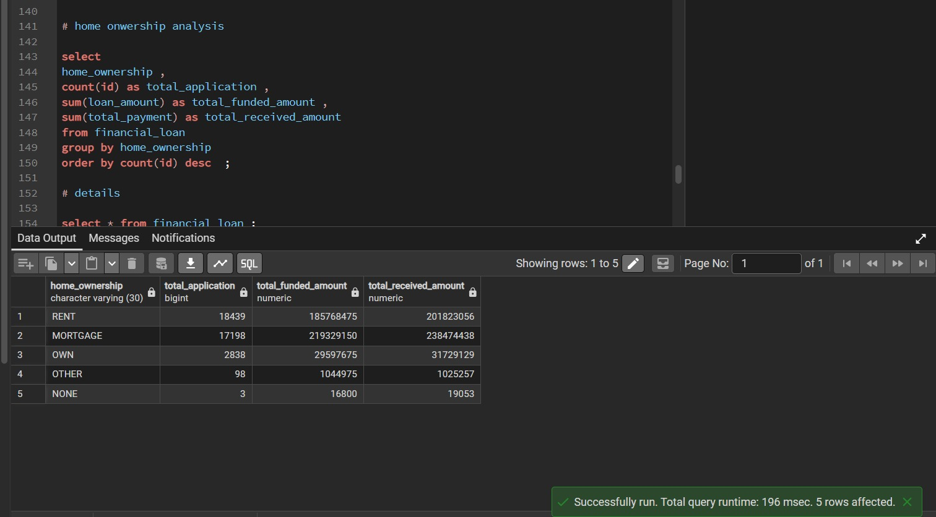
SQL/PostgreSQL

Slide 8
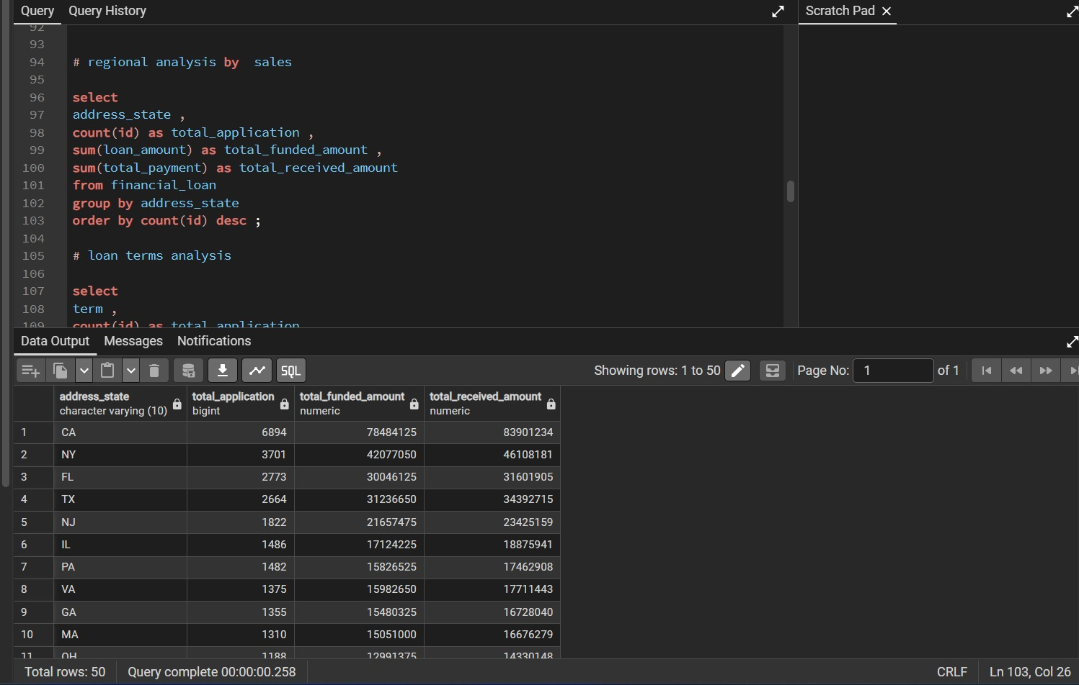
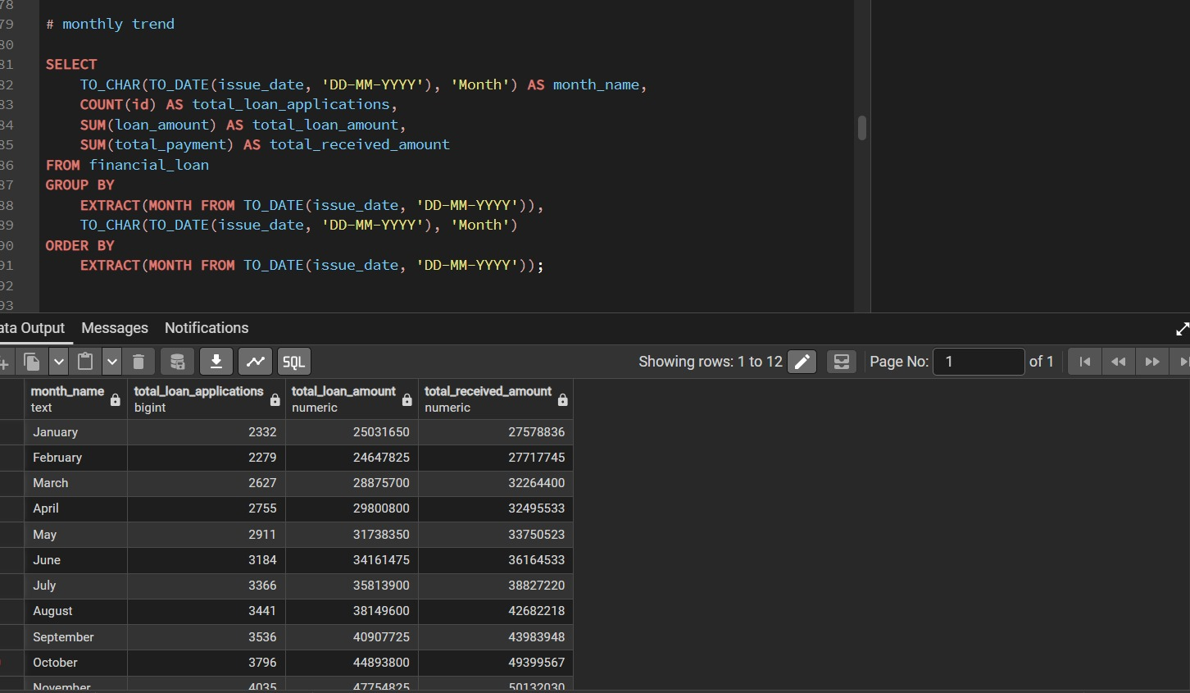

Slide 9
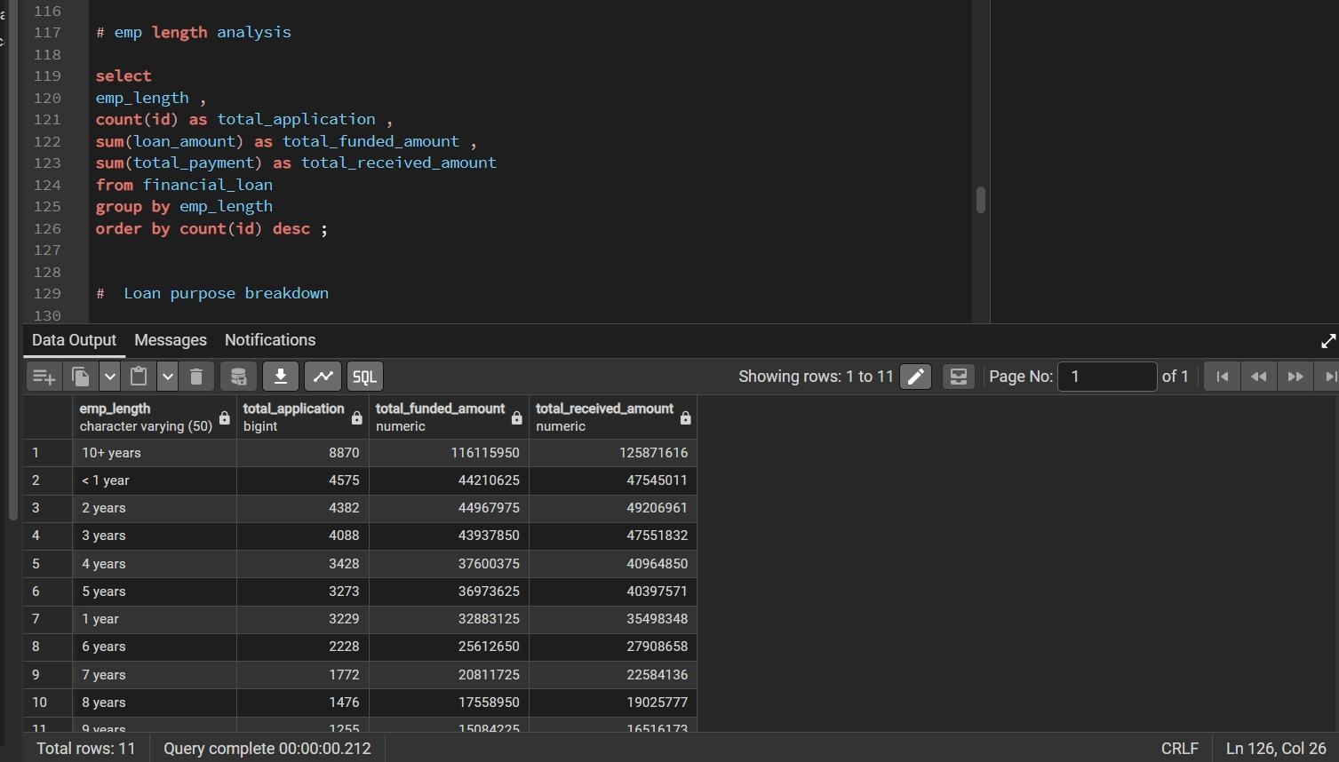
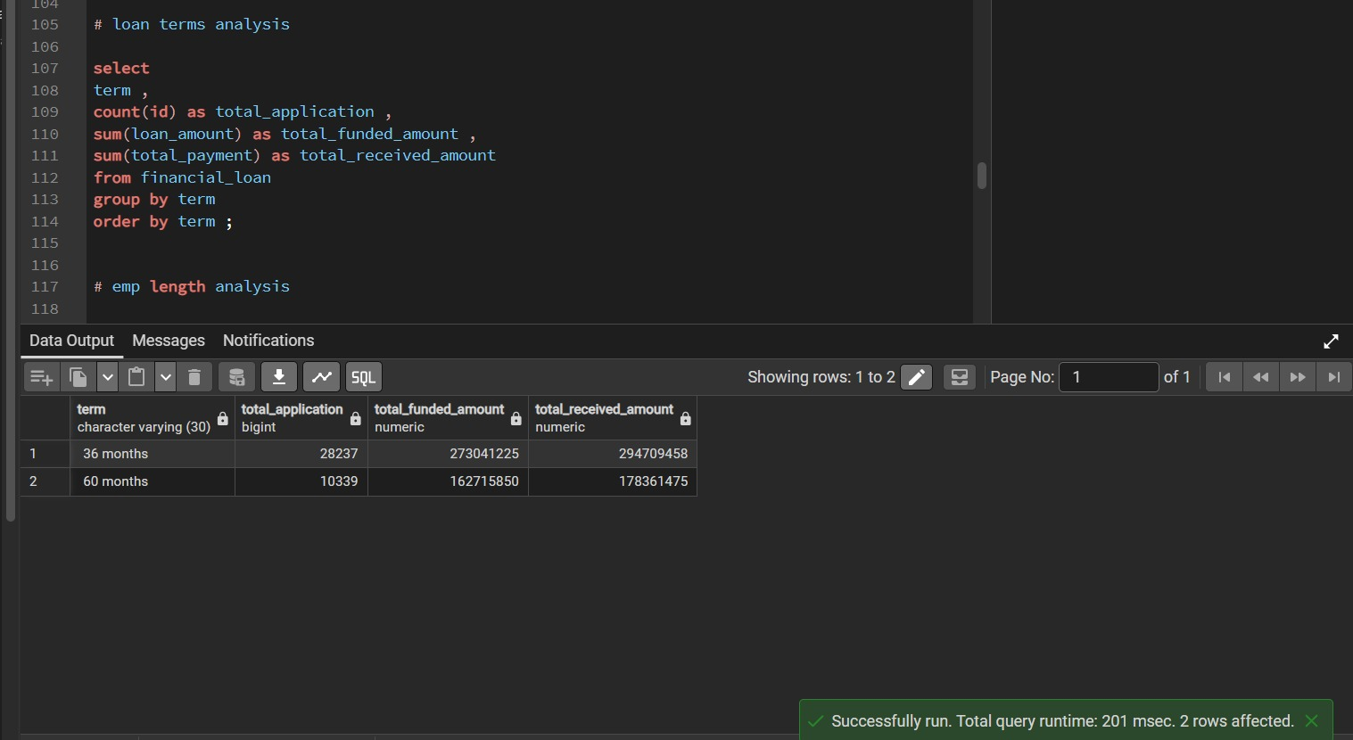

Slide 10
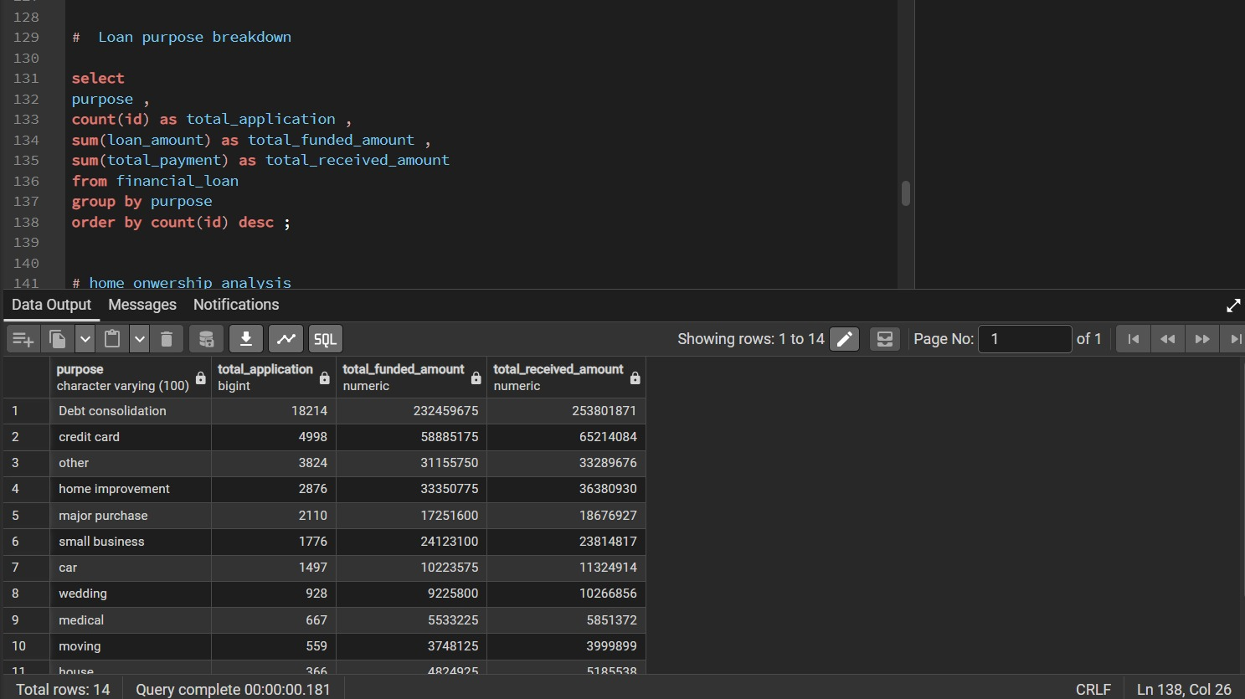
Dashboard of the Power Bi

Slide 11
Power BI

Slide 12
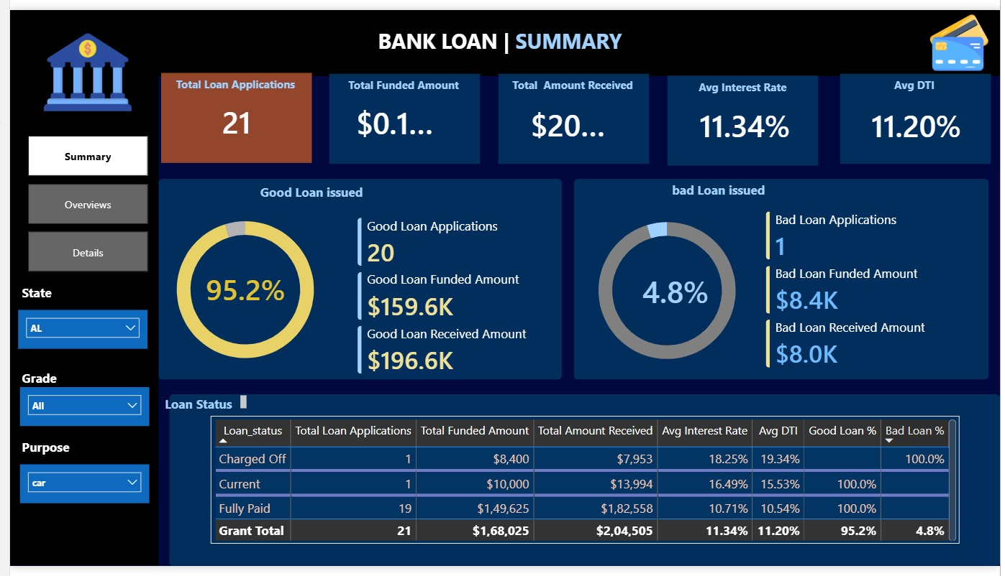

Slide 13
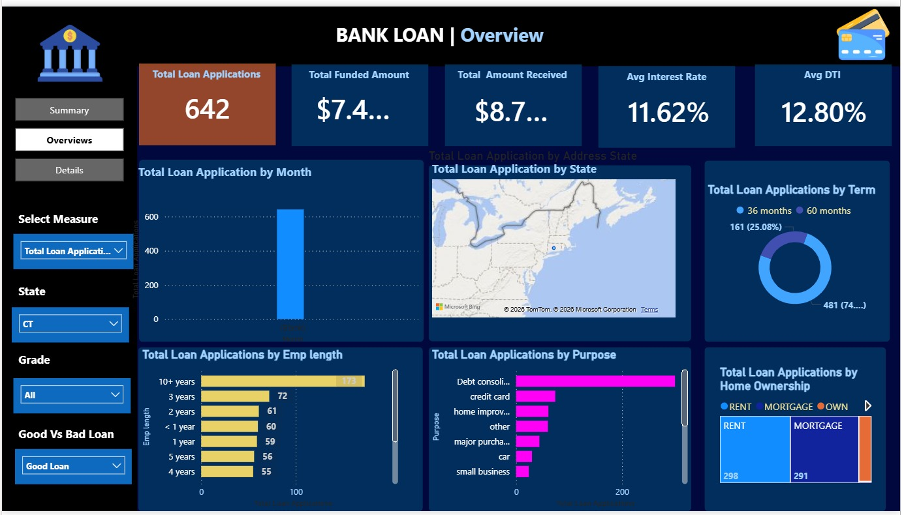
Add a Slide Title - 3

Slide 14
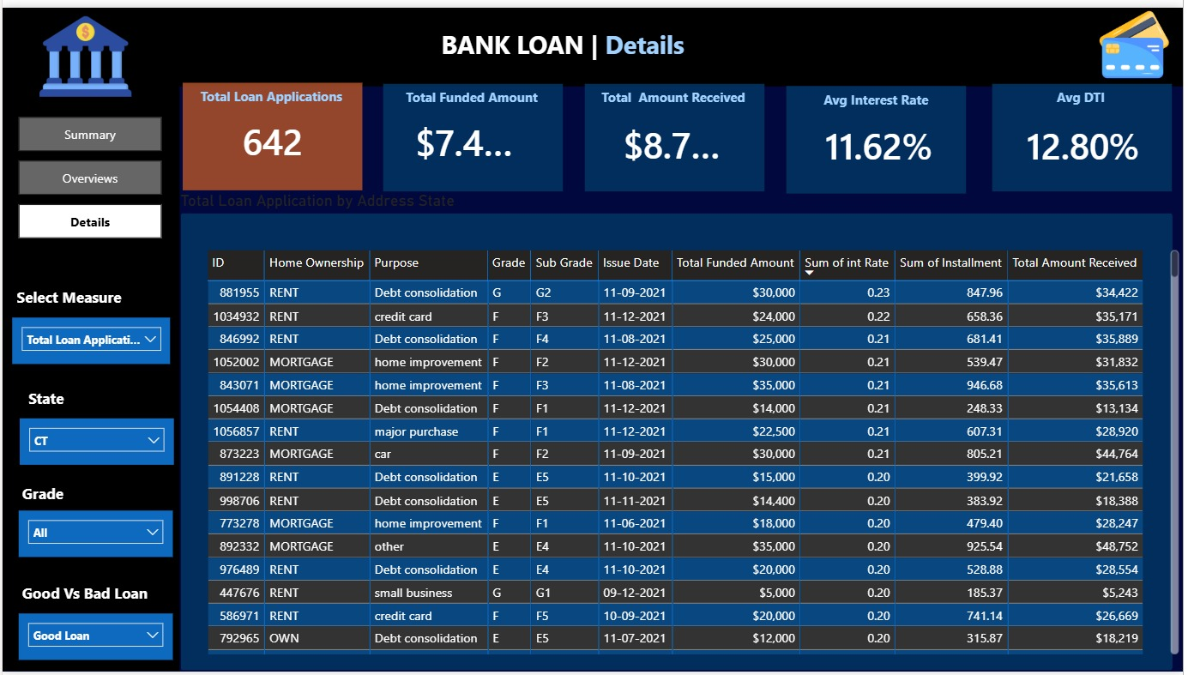

Slide 15
Key Insights
Loan Quality: The Summary dashboard shows 95.2% good loans and 4.8% bad loans under the selected filters.
Loan Applications: The dashboard tracks total loan applications and helps identify monthly trends.
Loan Funding and Repayment: Total funded amounts and total amounts received provide an overview of lending and repayment performance.
Borrower Analysis: Loan applications can be analyzed by employment length, home ownership, loan purpose, and loan grade.
Geographical Insights: State-wise analysis helps identify the distribution of loan applications across different regions.
Financial Risk Indicators: Average interest rates and debt-to-income (DTI) ratios help evaluate borrower financial profiles.

Slide 16
Conclusion
The Bank Loan Analysis Dashboard transforms raw loan data into meaningful insights using SQL/PostgreSQL and Microsoft Power BI. It provides a comprehensive analysis of loan applications, funded amounts, repayments, borrower profiles, and loan performance.
Through interactive dashboards, KPIs, charts, and filters, the project helps identify lending trends, compare good and bad loans, and assess potential credit risks. Overall, this project demonstrates the practical application of data analytics and visualization to support informed, data-driven financial decision-making.

